Slide 1
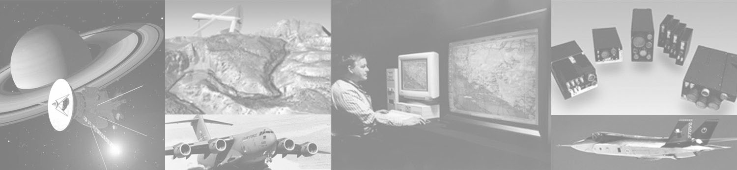
RADAR Test Plan
Team Finck BIG!
Bryan Finck, David Horne, Carlos Lazo, Rowland Stilwell

Slide 2
Agenda
Problem Definition
Measurements of Effectiveness (MoE)
Requirements
Test Range and Target Requirements

Slide 3
Problem Definition
Problem Set
  Detection of a target platform by stationary Early Warning RADAR (EWR)
Test Objective
  Can our RADAR simultaneously detect two targets at maximum range?

Slide 4
Measurements of Effectiveness (MoE)
RADAR detection data shall match the target platform’s time-tagged position data to show accurate detection
The RADAR shall be capable of detecting the altitude and range of at least 2 targets.
The number of targets detected by the RADAR

Slide 5
Requirements
The RADAR shall be capable of detecting the altitude and range of a target.
The RADAR shall be capable of detecting two targets which are at least 180m apart at the RADAR’s maximum detectable range.

Slide 6
Test Range and Target Requirements
Target Requirements
Test Range Requirements
Target | Desired | Selected
RADAR Cross Section (m²) | 1 | 1
Altitude (km) |  | 11
Test Range | Desired | Selected
Range (km²) | 400 | 7000
Target Altitude Limit (m) |  | 25,908
RADAR Altitude | Sea Level | Sea Level
Nominal Operating Temperature | 16°C | Month: October Nominal: 16°C Range: 12-20°C
Airspace (km²) |  | 500 x 500

Slide 7
Pax River Details
Sea level
Picture
Show flight path
Leave runway
To radar detection range
Circle to represent detection range
show flight path

Slide 8
Test Method
Picture
1 out of range
2 at max range targets close
>180 meters
3 Greater than minimum target seperation

Slide 9
Test Instrumentation
What are we using to do the test

Slide 10
Test Plan
What we are going to do

Slide 11
Data Analysis
What we will do with the data

Slide 12
Expected Results
What the data should be

Slide 13
BACKUP SLIDES

Slide 14
Requirements
Requirement ID Number | Requirement | Verification Method
SYS_01 | The RADAR shall have a maximum detectable range of 194.865 ± 4km | T
SYS_02 | The RADAR shall be capable of detecting targets at maximum range at least 95% of the time | A
SYS_03 | The RADAR shall be capable of detecting target position with a minimum accuracy of 90% | A
SYS_04 | The RADAR shall be able to detect a target with a minimum RADAR Cross Section (RCS) of one square meter | T
SYS_05 | The RADAR shall have a minimum sensitivity of -126 dBm | T
SYS_06 | The RADAR shall be capable of detecting two targets which are at least 180m apart at the maximum detectable range | T
SYS_07 | Input power shall not exceed 100 watts | I
SYS_08 | Weight shall not exceed 20.1 tons | I
SYS_09 | Size shall not exceed 10 meters x 10 meters x 10 meters | I
SYS_10 | The RADAR shall be capable of detecting the azimuth angle, elevation angle, and range of a target | T
SYS_11 | The RADAR beam width shall be 2 degrees +/- .1 degrees | T
SYS_12 | The RADAR shall have an operating frequency of 3.3 GHz +/- 416 MHz | T
SYS_13 | The RADAR shall have a bandwidth of 833 MHz | T
SYS_14 | The RADAR shall have a minimum spin rate of 36 degrees per second | A
SYS_15 | The RADAR shall be capable of operating when exposed to temperatures between -50 °C and 60 °C | T
SYS_16 | The RADAR shall be capable of operating when exposed to a maximum environmental loss of 6 dBi | T
SYS_17 | The RADAR shall operate
ADD REQUIREMENT FROM TEST PLAN, BITCH!!
A = Analysis
I = Inspection
T = Test

